Slide 1
effect on global economy due to rise in global conflicts.
Group 2
An analysis of economic consequences in an interconnected world

Slide 2
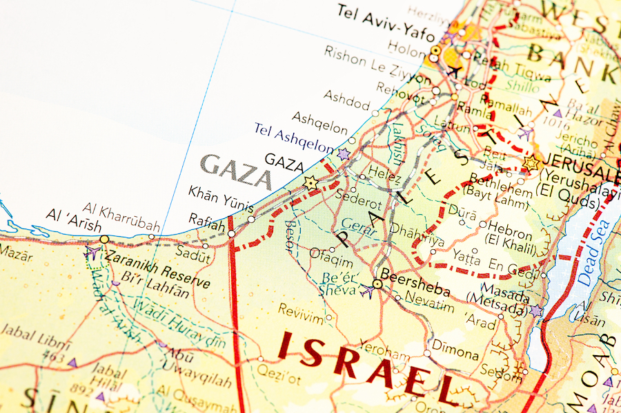
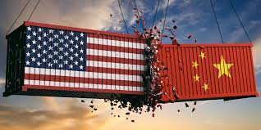
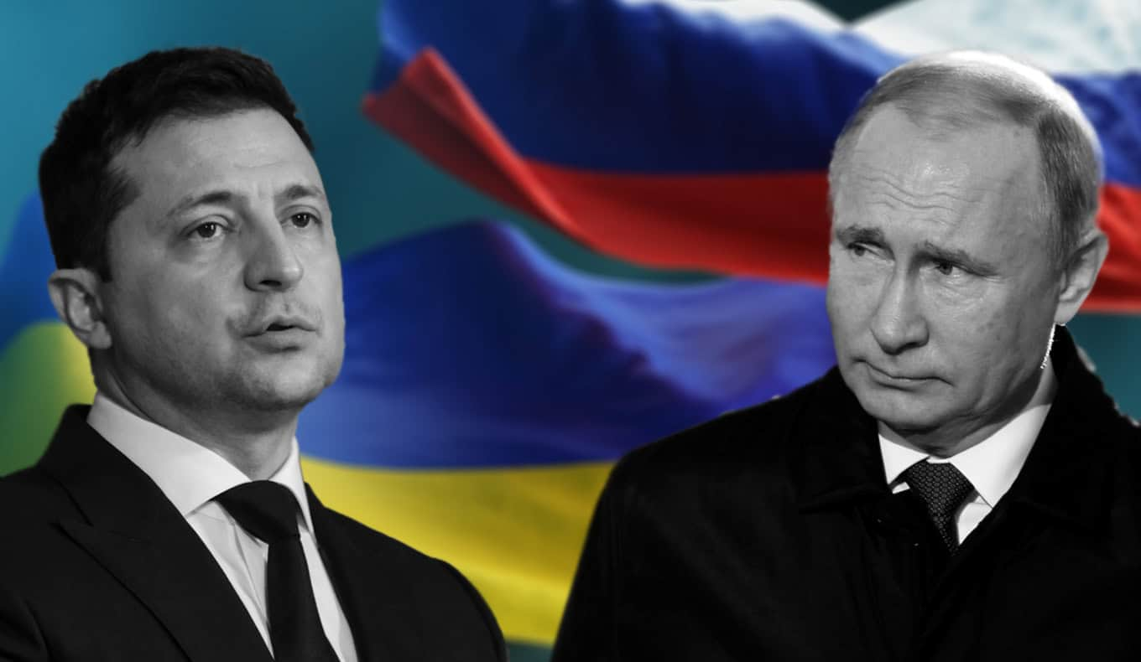
Introduction
More than just headlines: Conflicts have real economic costs.
Recent years have seen a significant increase in geopolitical instability and armed conflicts.
In a globalized world, the economic effects are no longer contained within conflict zones.
This presentation will explore the primary channels through which conflicts impact the global economy.

Slide 3
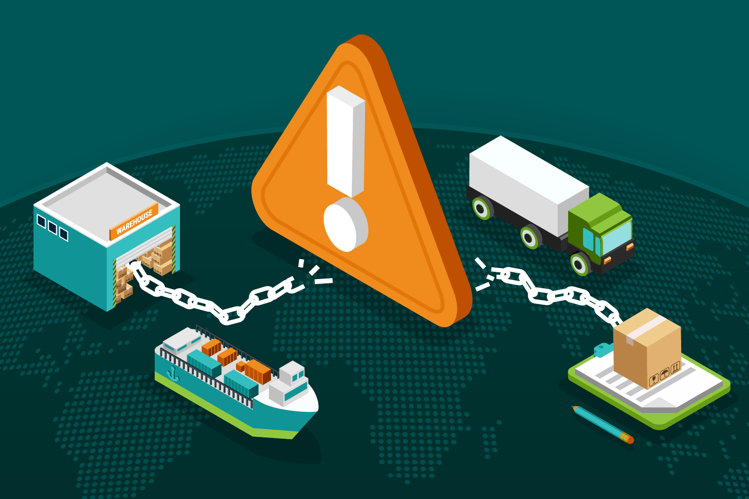
The Primary Channels of Economic Disruption
How Conflict Disrupts the Global Economic Engine
Supply Chain Disruptions: Production halts and trade routes are severed.
Energy & Commodity Shocks: Prices for oil, gas, grain, and metals become volatile.
Investment Uncertainty: Capital flees from instability, stalling projects and growth
Inflationary Pressures: Supply shocks and uncertainty drive up prices globally.

Slide 4

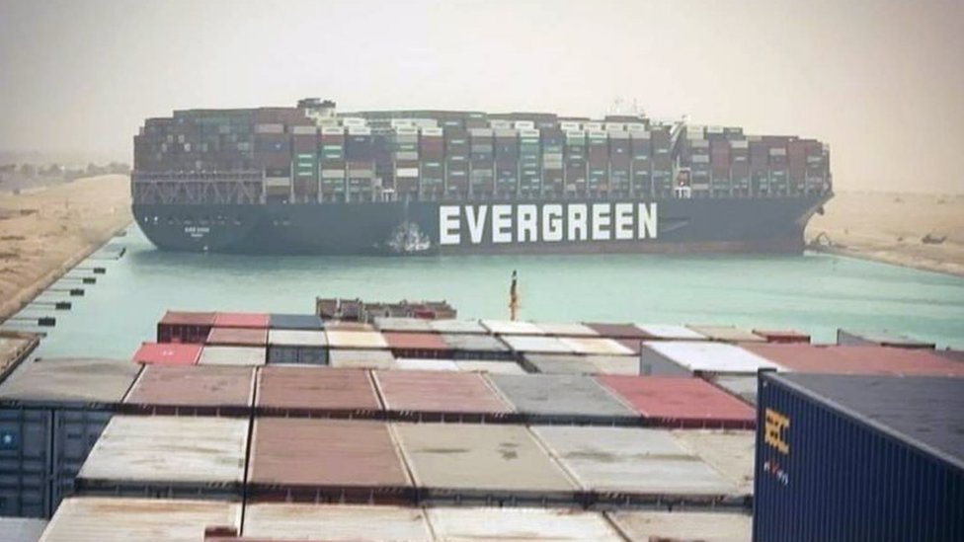

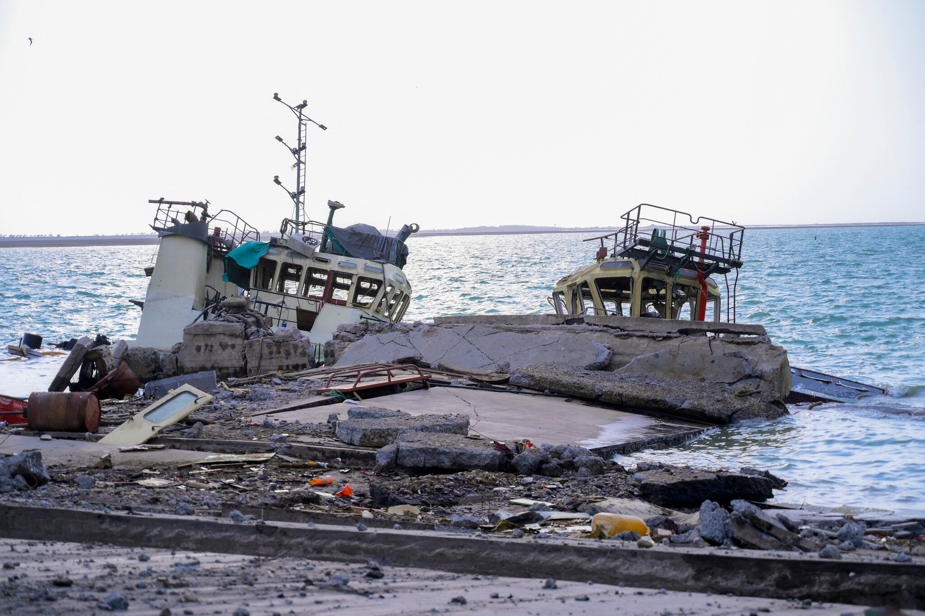
Deep Dive: Supply Chain Disruptions
Breaking the Chains of Global Trade
Physical Destruction: Damage to ports, roads, and factories (e.g., infrastructure in Ukraine).
Blocked Trade Routes: Vital shipping lanes become high-risk or impassable (e.g., the Red Sea and the Suez Canal).
Sanctions & Embargoes: Political tools that sever economic ties and create supply bottlenecks.
Result: Delays, increased shipping costs, and shortages of key goods (from microchips to food).

Slide 5

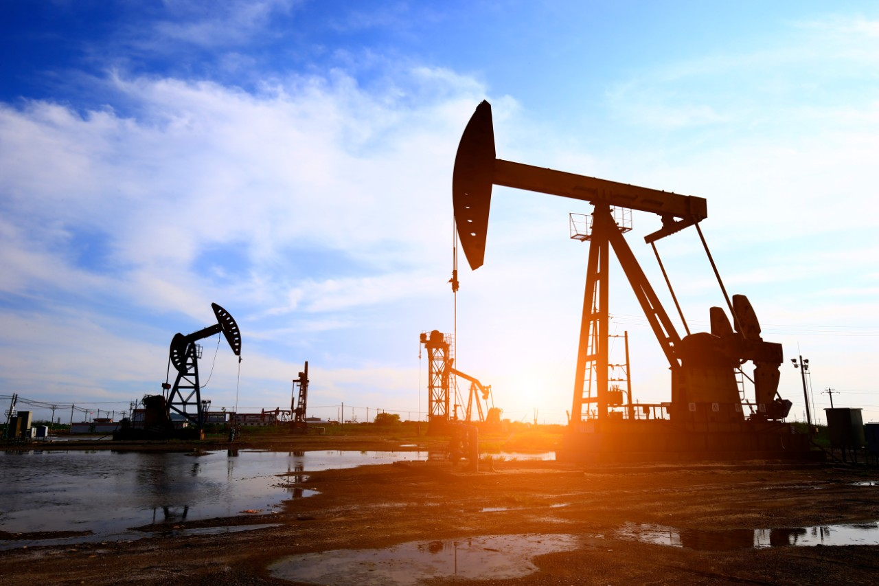
Deep Dive: Energy & Commodity Price Shocks
Fueling Volatility and Uncertainty
Conflicts often occur in regions rich in natural resources.
Case Study:
Russia-Ukraine War:
Russia is a major exporter of oil and natural gas.
Ukraine is a "breadbasket," exporting massive amounts of wheat, corn, and sunflower oil.
Impact:
European energy crisis and a global search for alternative suppliers.
Spikes in global food prices, threatening food security in developing nations.

Slide 6
The Inflationary Spiral
How Geopolitics Hits Your Wallet
Higher energy costs increase prices for everything (transport, manufacturing, heating).
Higher food costs directly impact household budgets.
Supply chain issues mean fewer goods are available, pushing prices up (basic supply and demand).
Central banks respond by raising interest rates, which can slow down economic growth.

Slide 7
Eroding Confidence: Investment & Financial Markets
Capital is a Coward: Instability Scares Away Investment
Capital Flight: Investors pull money out of conflict regions and neighboring countries.
Delayed Foreign Direct Investment (FDI): Companies postpone plans to build new factories or enter new markets.
Stock Market Volatility: Global indices react negatively to news of new or escalating conflicts.
Increased Defense Spending: Governments divert funds from productive sectors (education, infrastructure, healthcare) to the military.

Slide 8
The Human Factor: Refugees and Brain Drain
The Economic Cost of Human Displacement
Conflicts create massive refugee crises, placing economic strain on host nations (housing, food, healthcare).
Loss of skilled labor and "brain drain" from the conflict-affected country cripples its potential for future recovery.
Disruption of education and health services has long-term negative economic consequences for generations.

Slide 9
Conclusion - The Path Forward
An Unstable World is an Impoverished World
The economic impacts of global conflicts are profound, interconnected, and felt globally.
They fuel inflation, disrupt trade, and hinder long-term investment and growth.
There is a clear economic incentive—in addition to the moral and human imperative—for diplomacy, de-escalation, and international cooperation.

Slide 10
thank you.
questions?

